Slide 1
PCIe controller
2020311096 김준태
2020311400 박세빈
2020310727 유승현
2020310663 홍성필

Slide 2
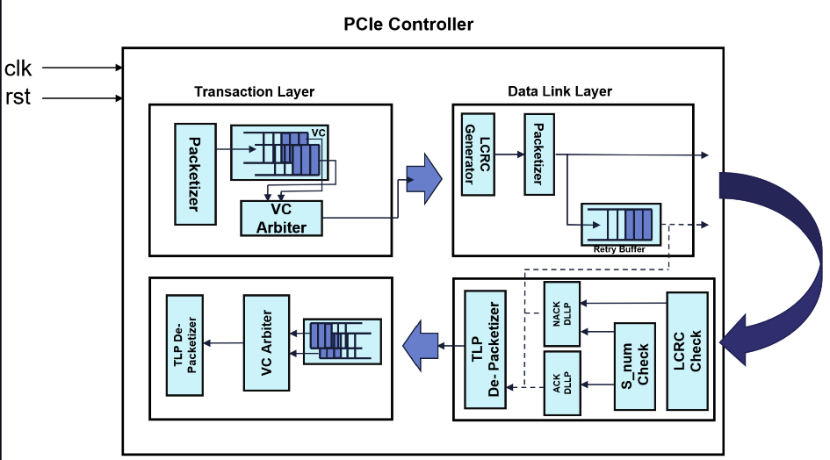
>>
Project objective
Part 1

Slide 3
Module

Slide 4
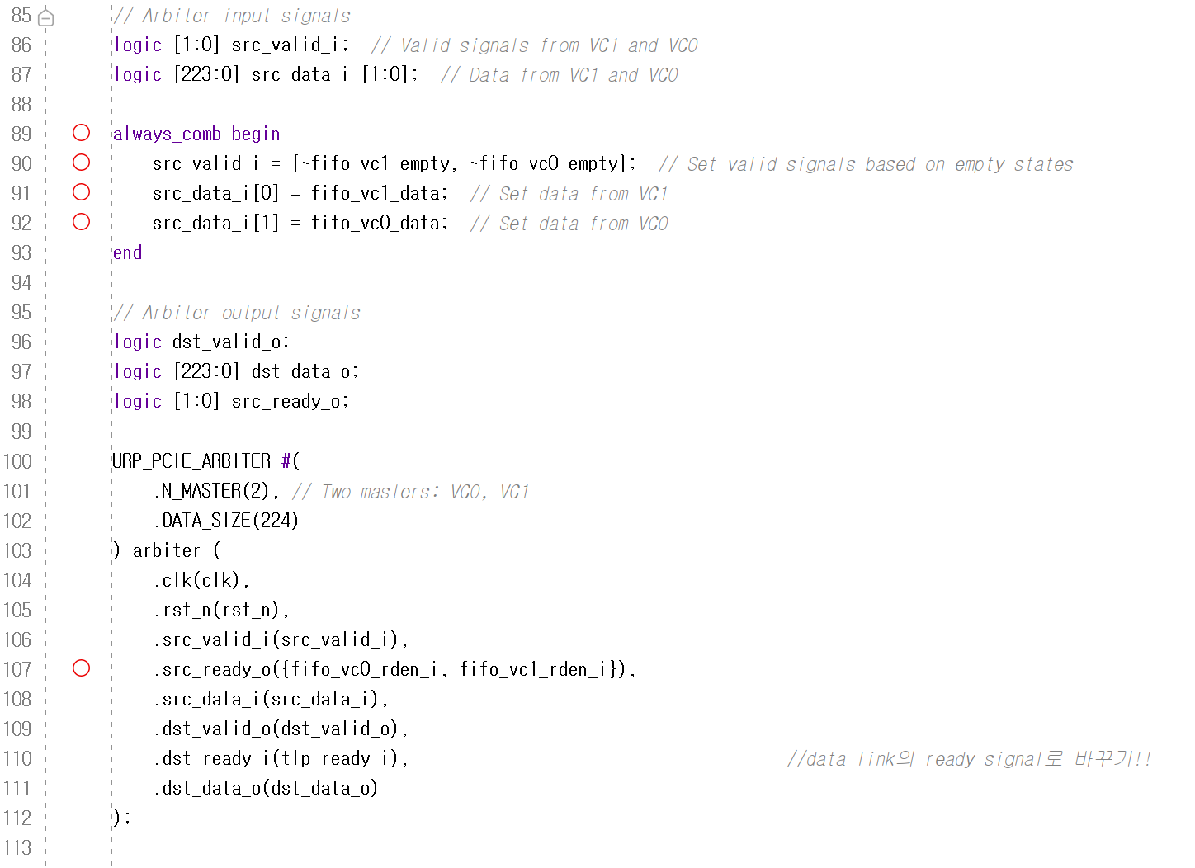
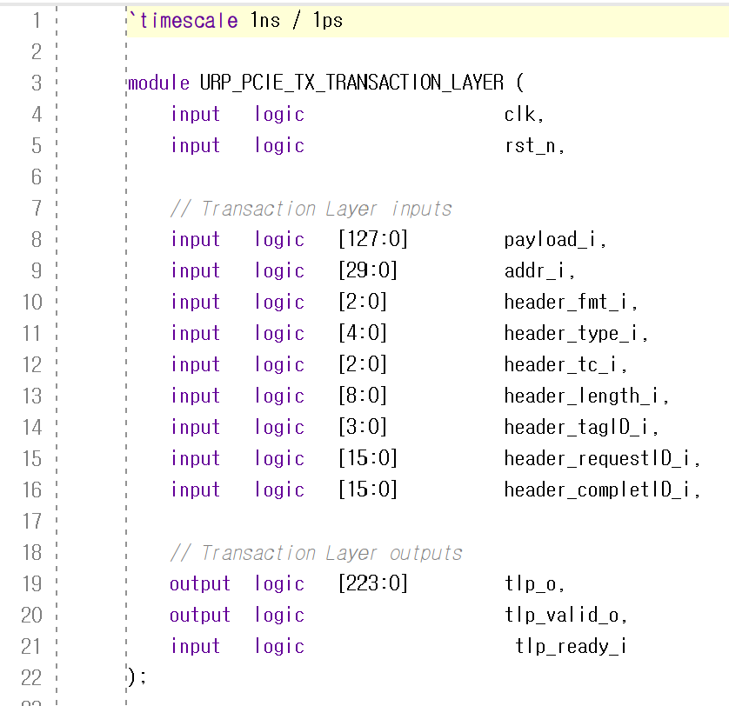
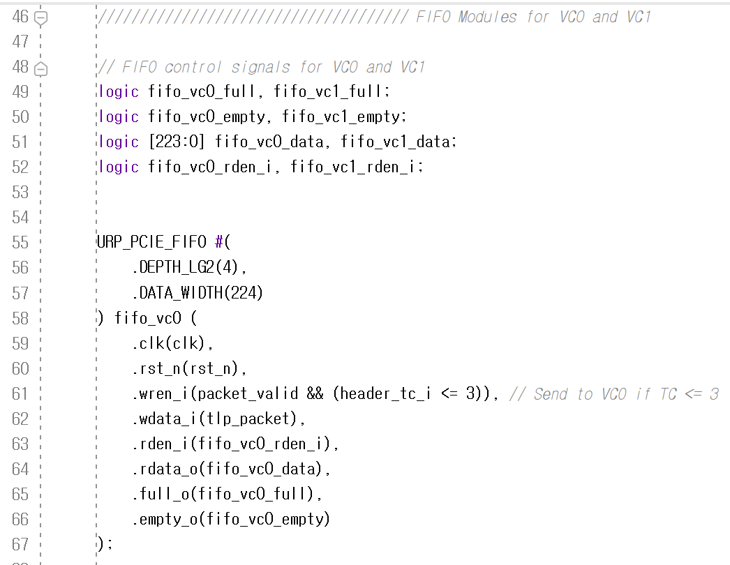
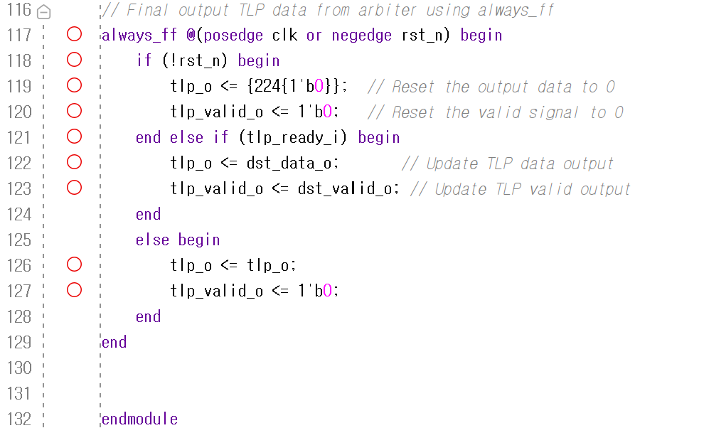
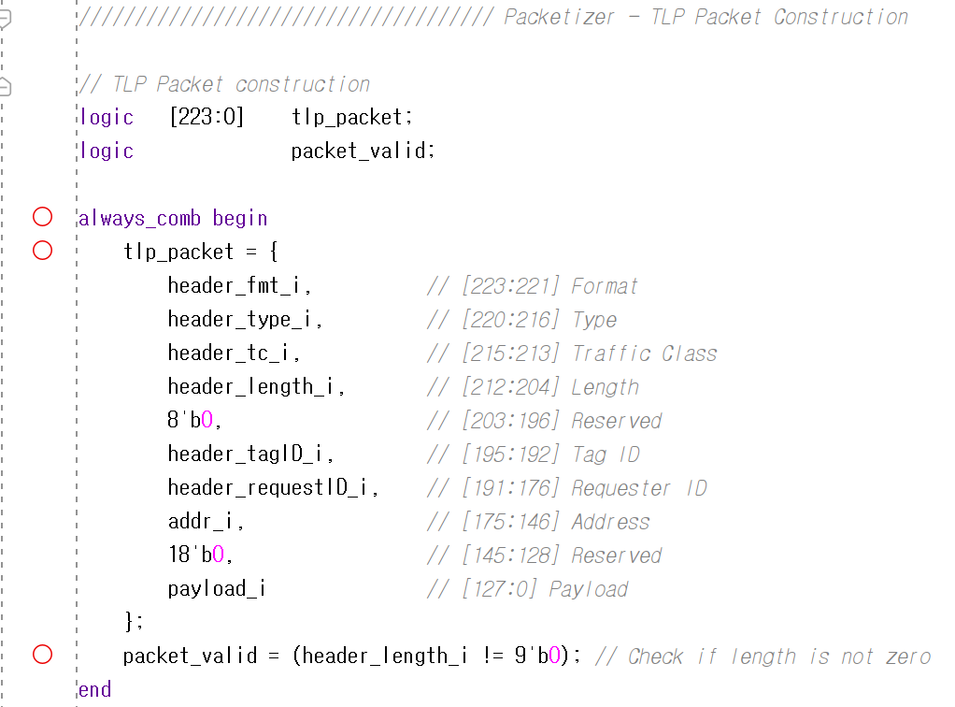
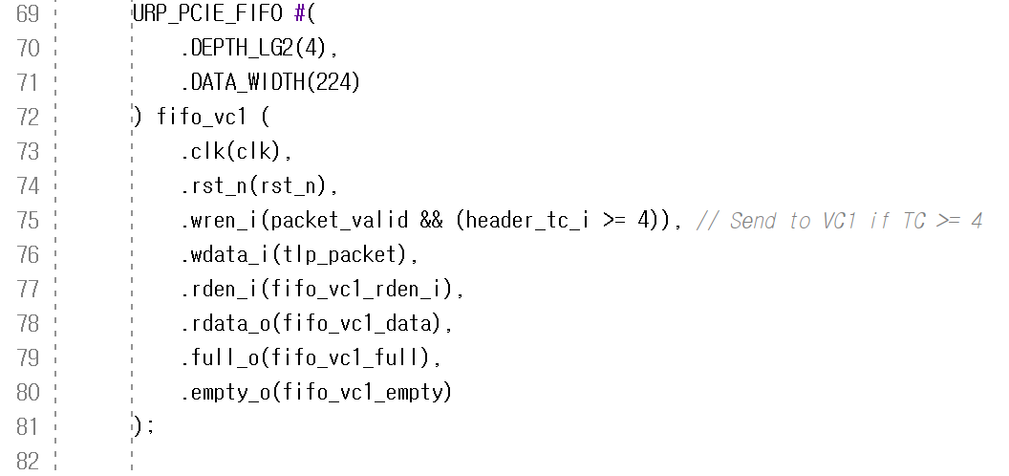
>>
TX_Transaction_Layer Module
Part 2-1
System Verilog implementation

Slide 5
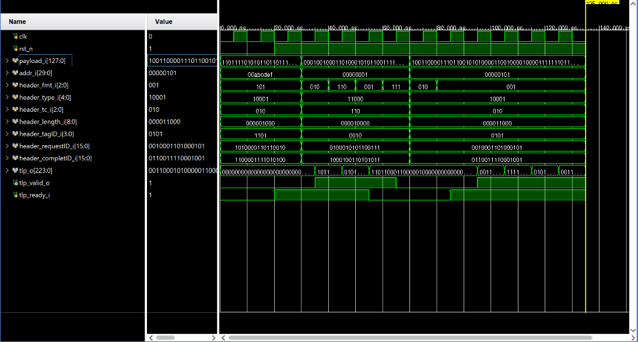
>>
TX_Transaction_Layer Module
Part 2-1
Simulation Result

Slide 6
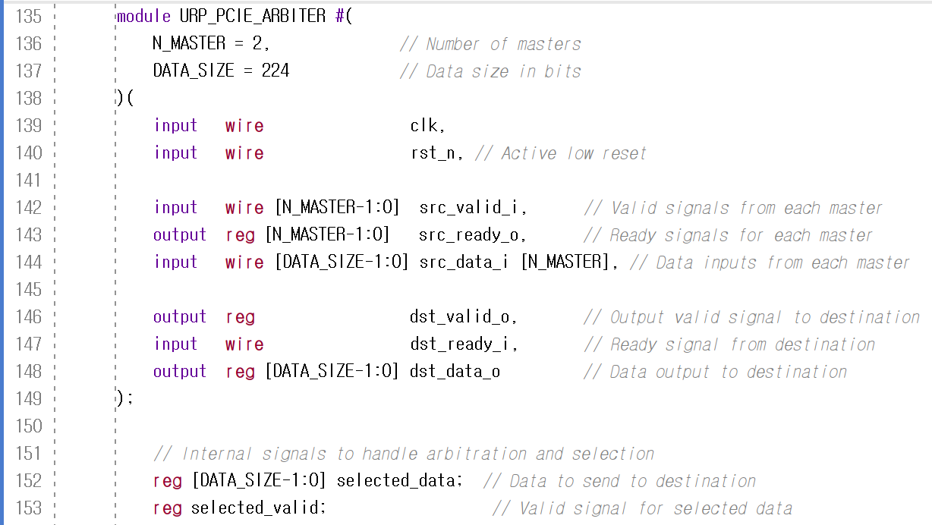
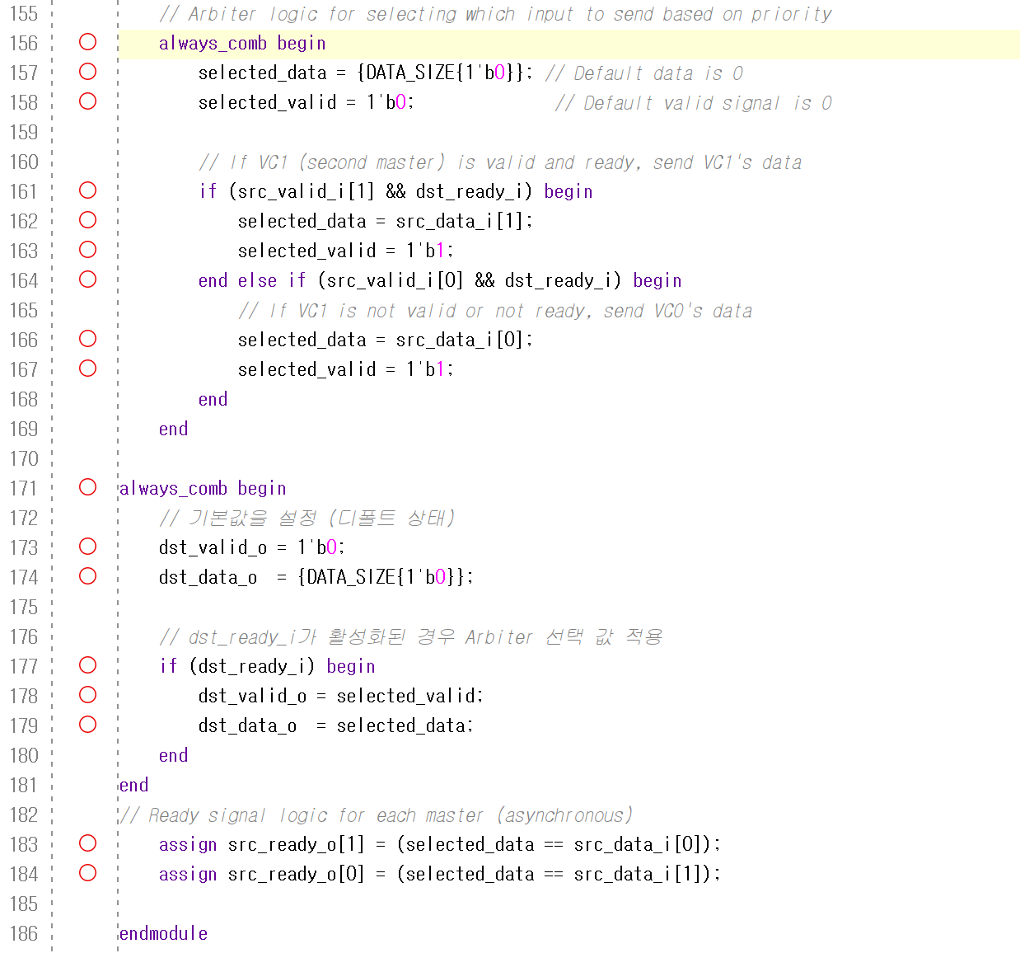
>>
Arbiter Module
Part 2-1
System Verilog implementation

Slide 7
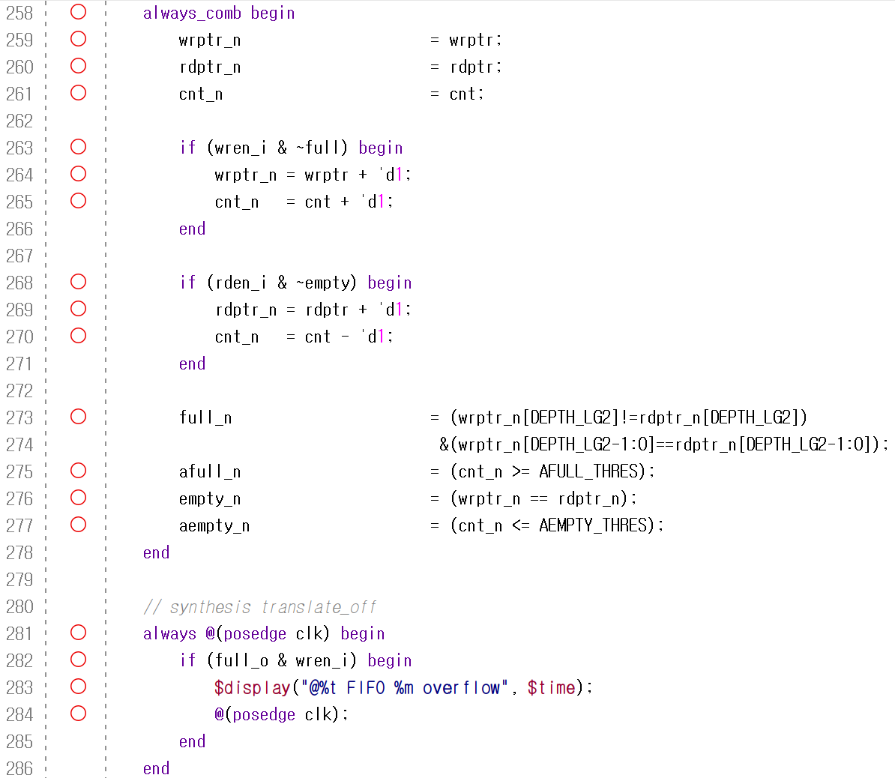
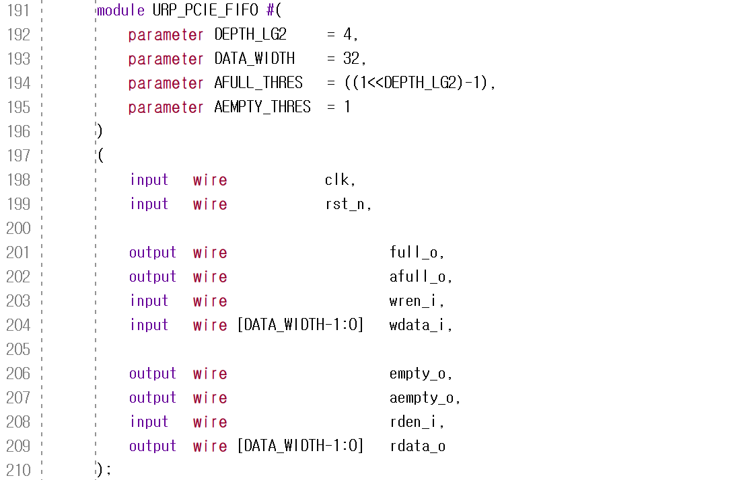
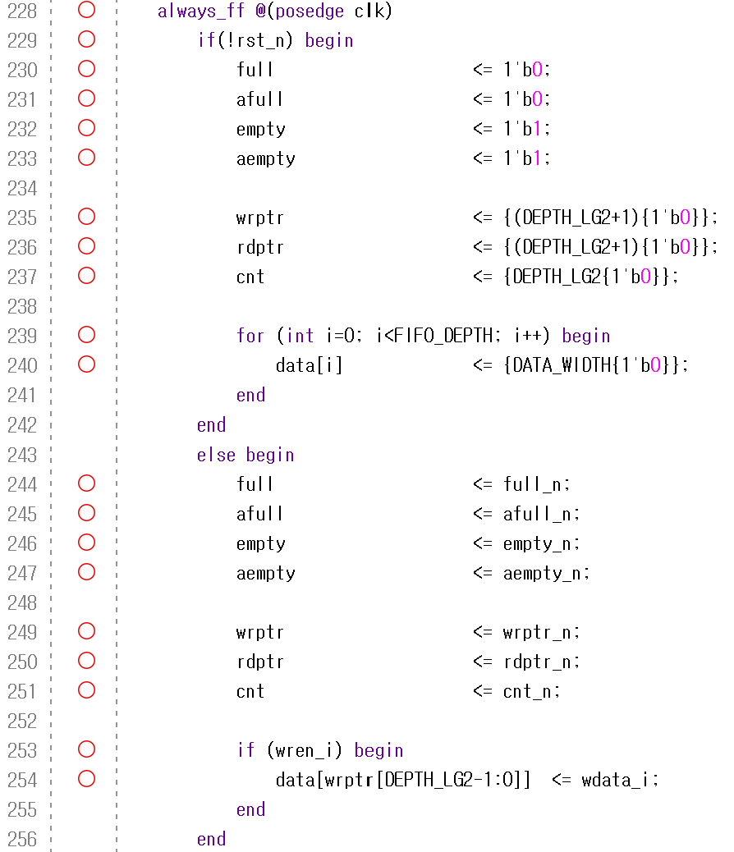
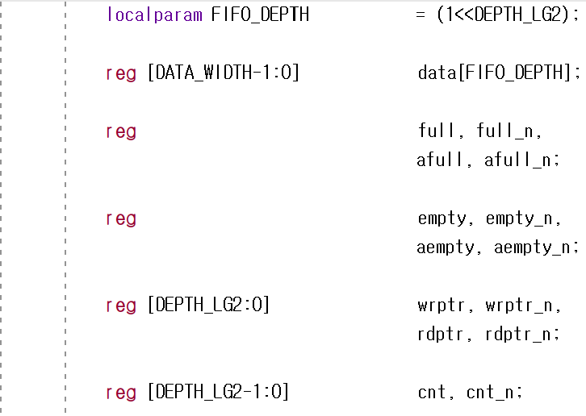
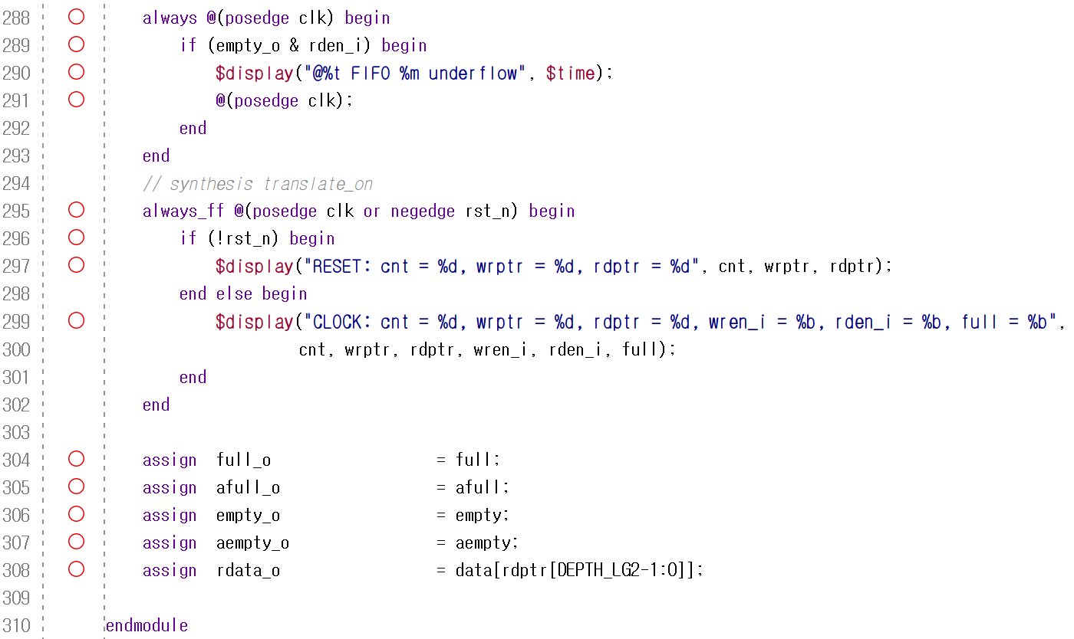
>>
FIFO Module
Part 2-1
System Verilog implementation

Slide 8
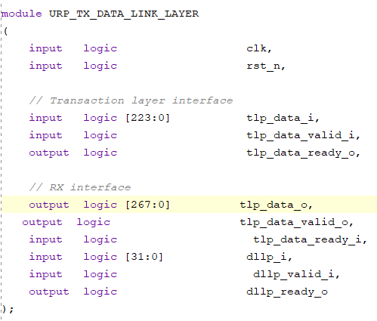
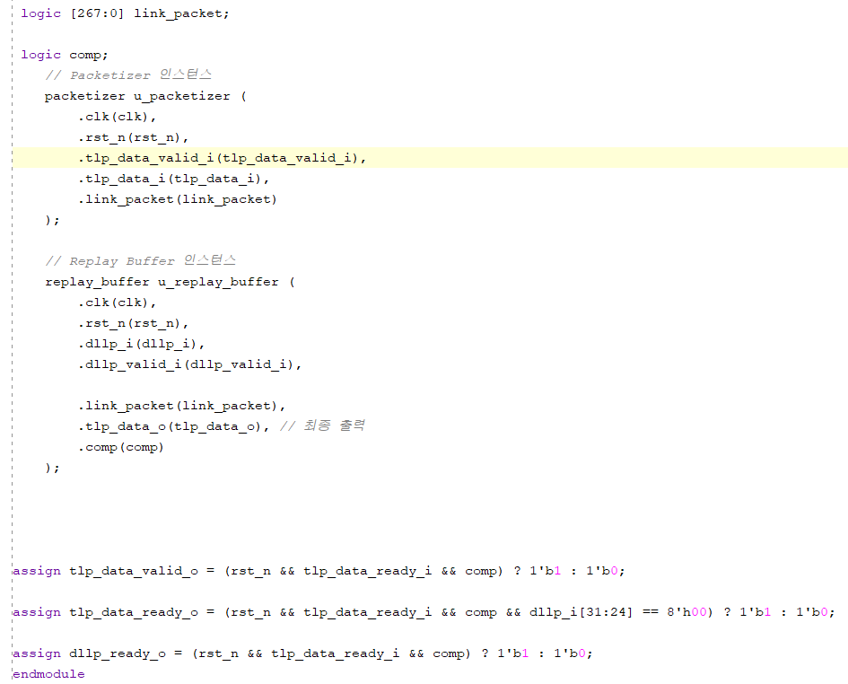
>>
TX_Data Link Layer module
Part 2-2
System Verilog implementation

Slide 9
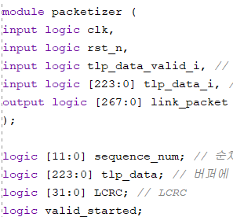
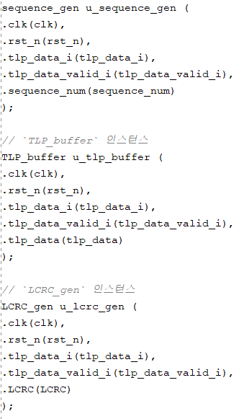
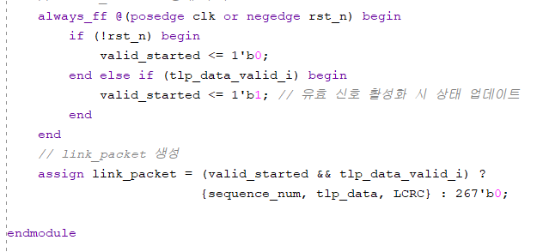
>>
Packetizer module
Part 2-2
System Verilog implementation

Slide 10
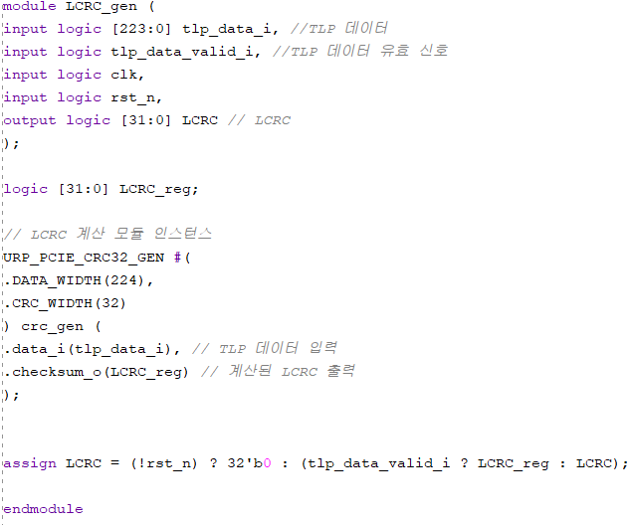
>>
LCRC_gen module
Part 2-2
System Verilog implementation

Slide 11
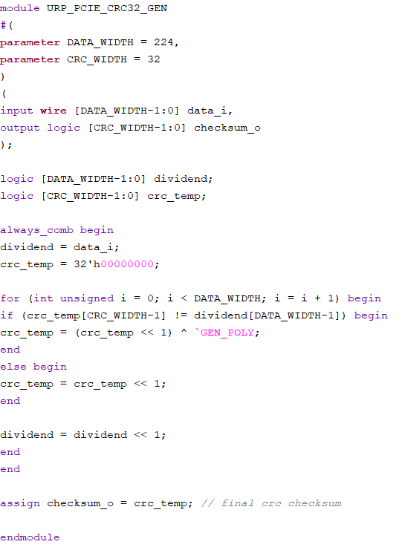
>>
CRC32_GEN module
Part 2-2
System Verilog implementation

Slide 12
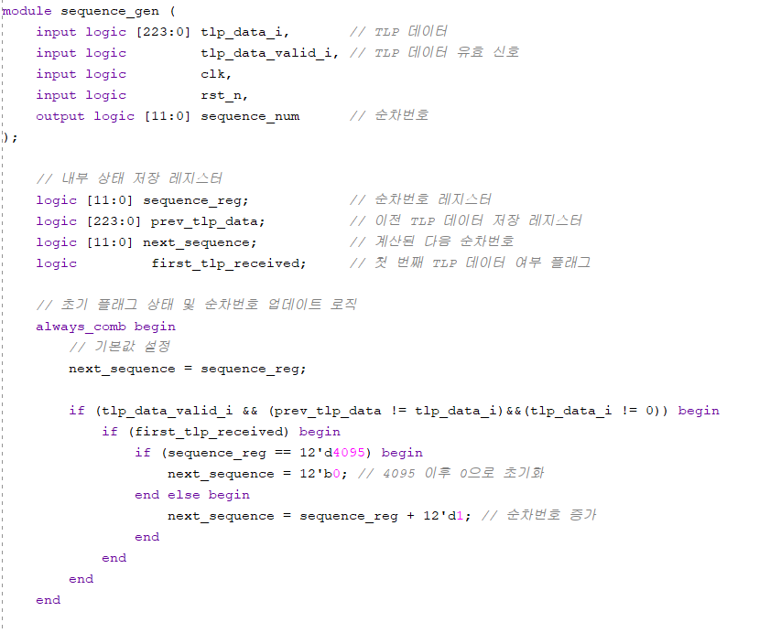
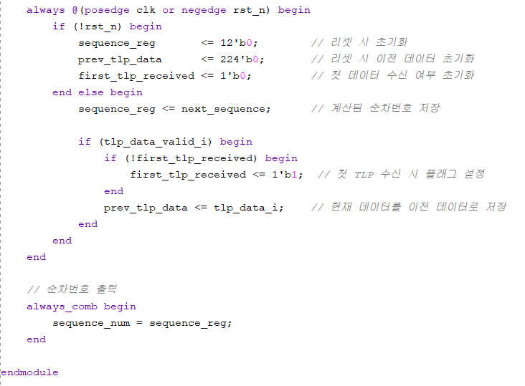
>>
Sequence_gen module
Part 2-2
System Verilog implementation

Slide 13
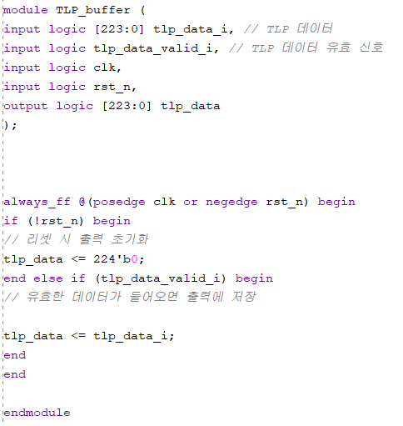
>>
TLP_buffer module
Part 2-2
System Verilog implementation

Slide 14
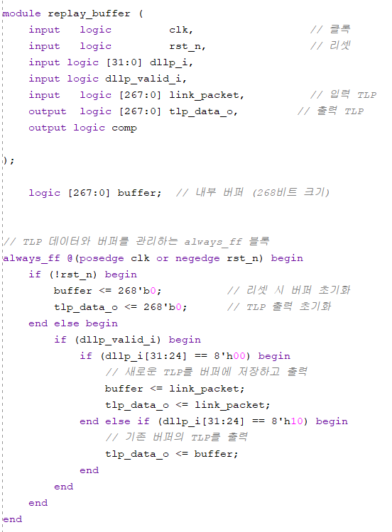
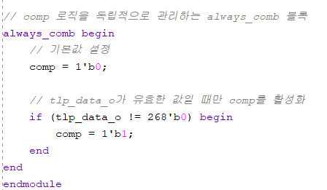
>>
replay_buffer module
Part 2-2
System Verilog implementation

Slide 15
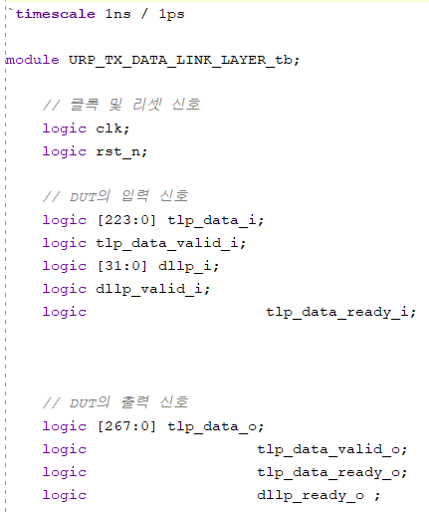
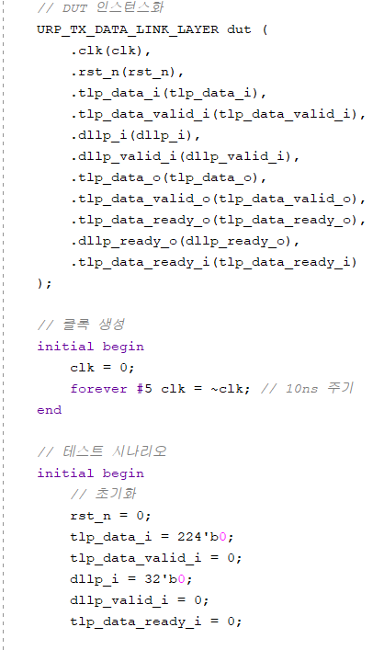
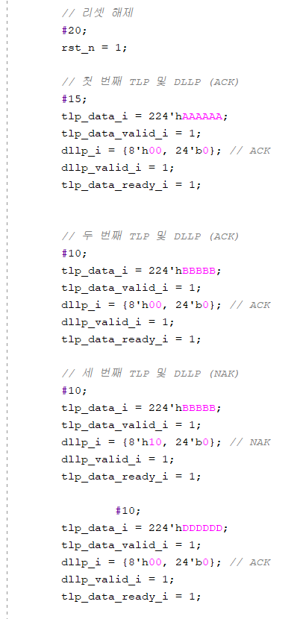
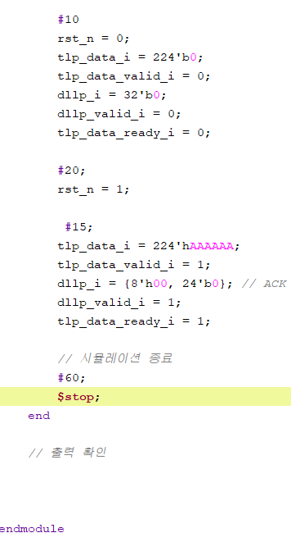
>>
Testbench module
Part 2-2
System Verilog implementation

Slide 16
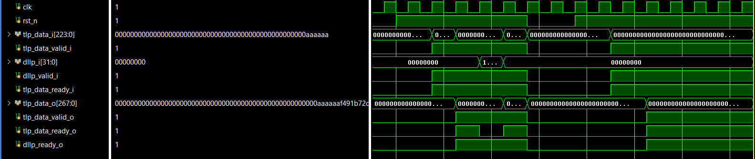
>>
Testbench module
Part 2-2
Simulation Result

Slide 17
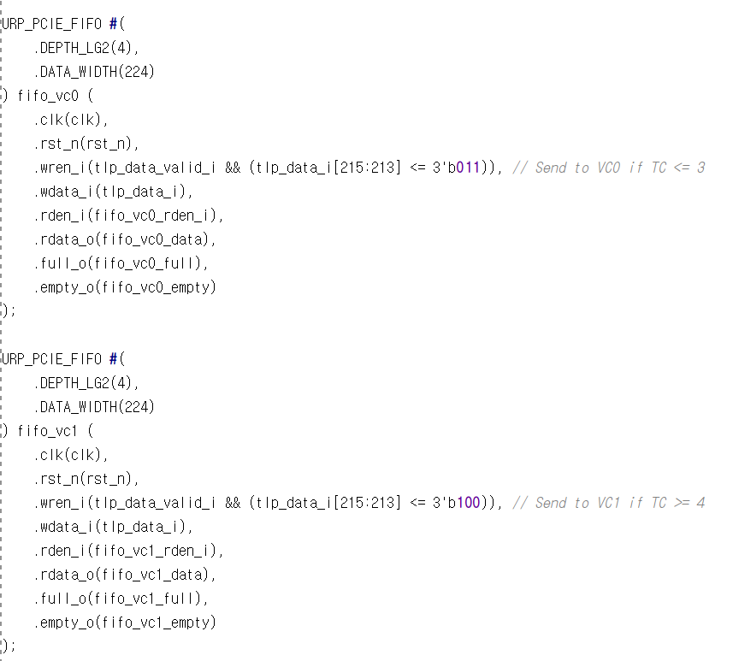
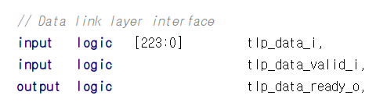
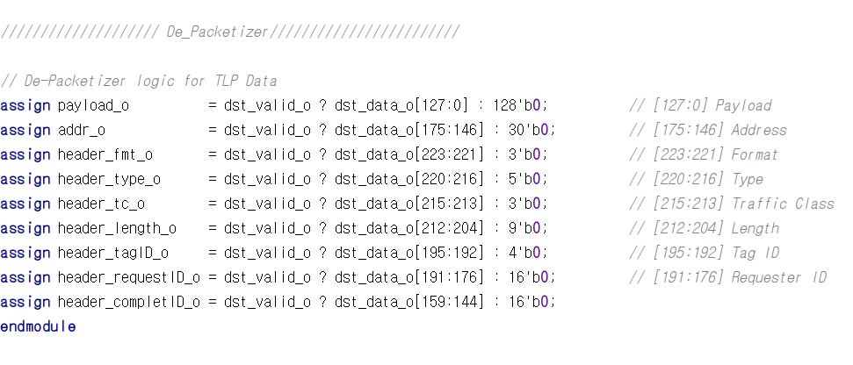
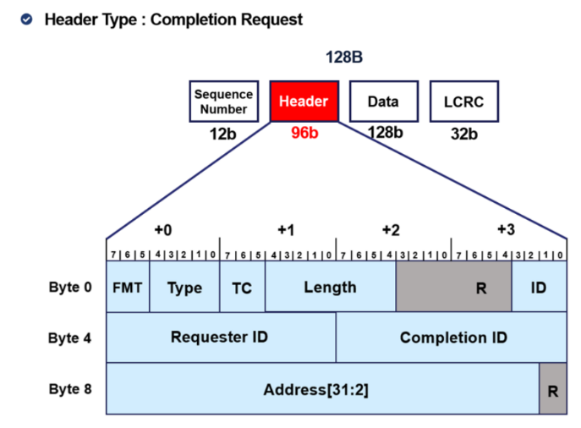
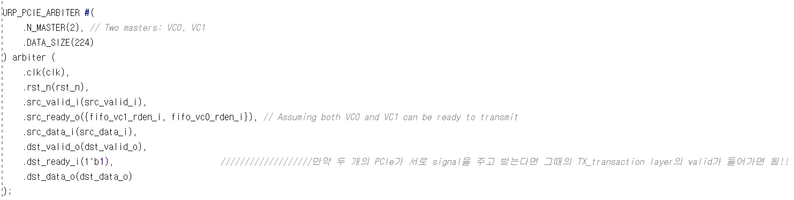
>>
RX_Transaction_Layer module
Part 2-3
System Verilog Implementation

Slide 18
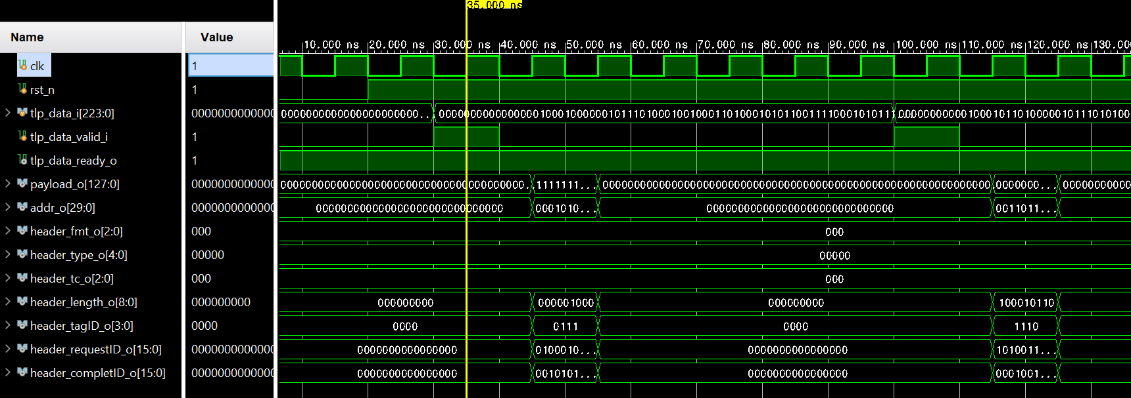
>>
RX_Transaction_Layer module
Part 2-3
Simulation Result
1) NAK

Slide 19
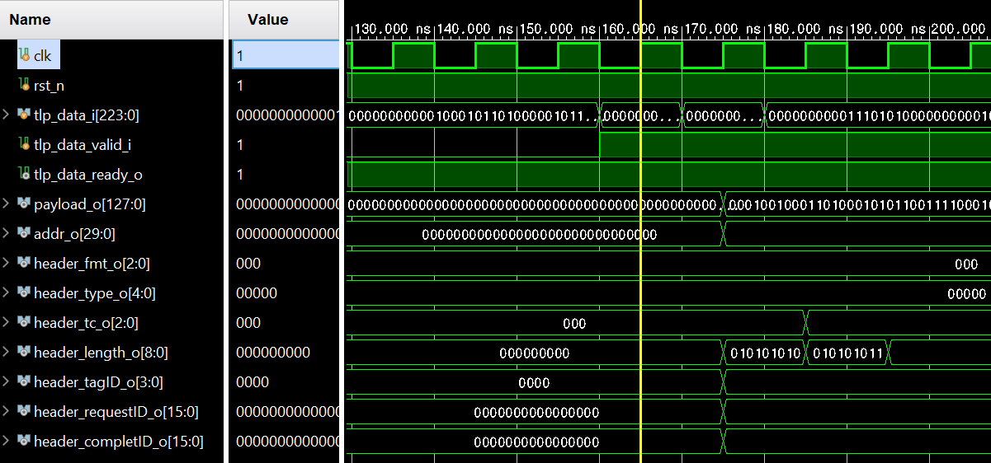
>>
RX_Transaction_Layer module
Part 2-3
Simulation Result
2) ACK

Slide 20
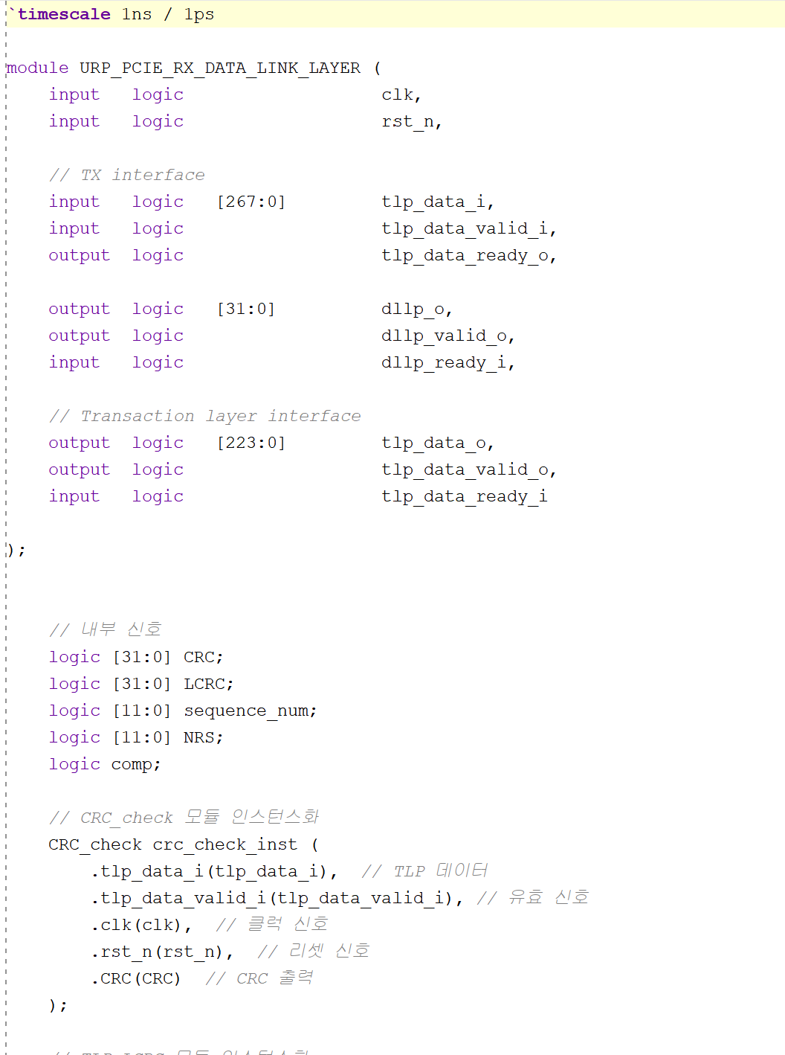
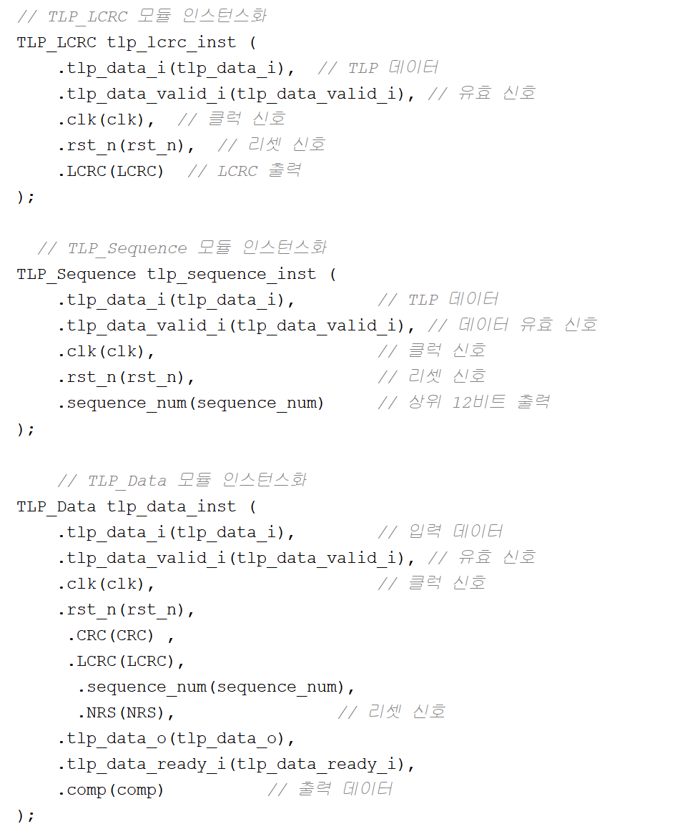
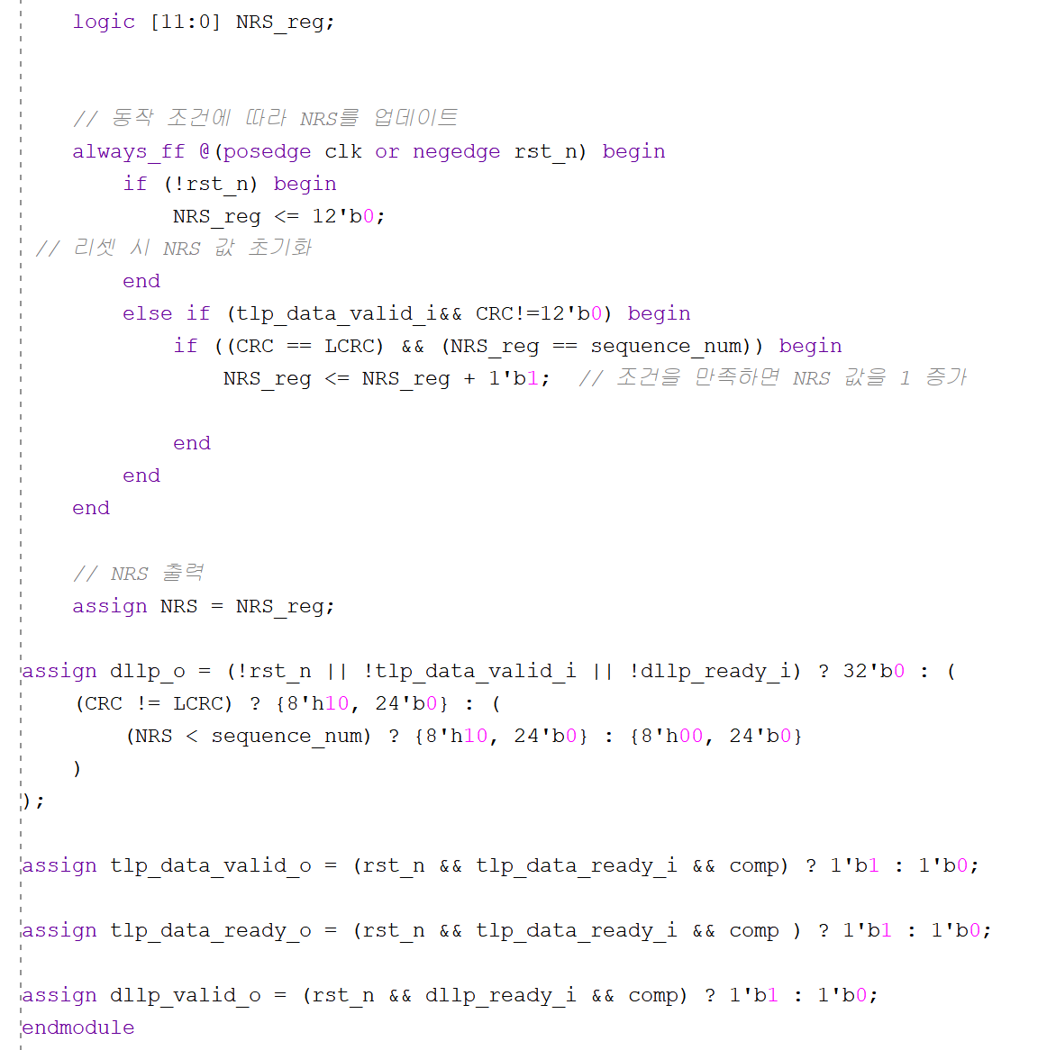
>>
RX_Datalink_Layer module
Part 2-4
System Verilog Implementation

Slide 21
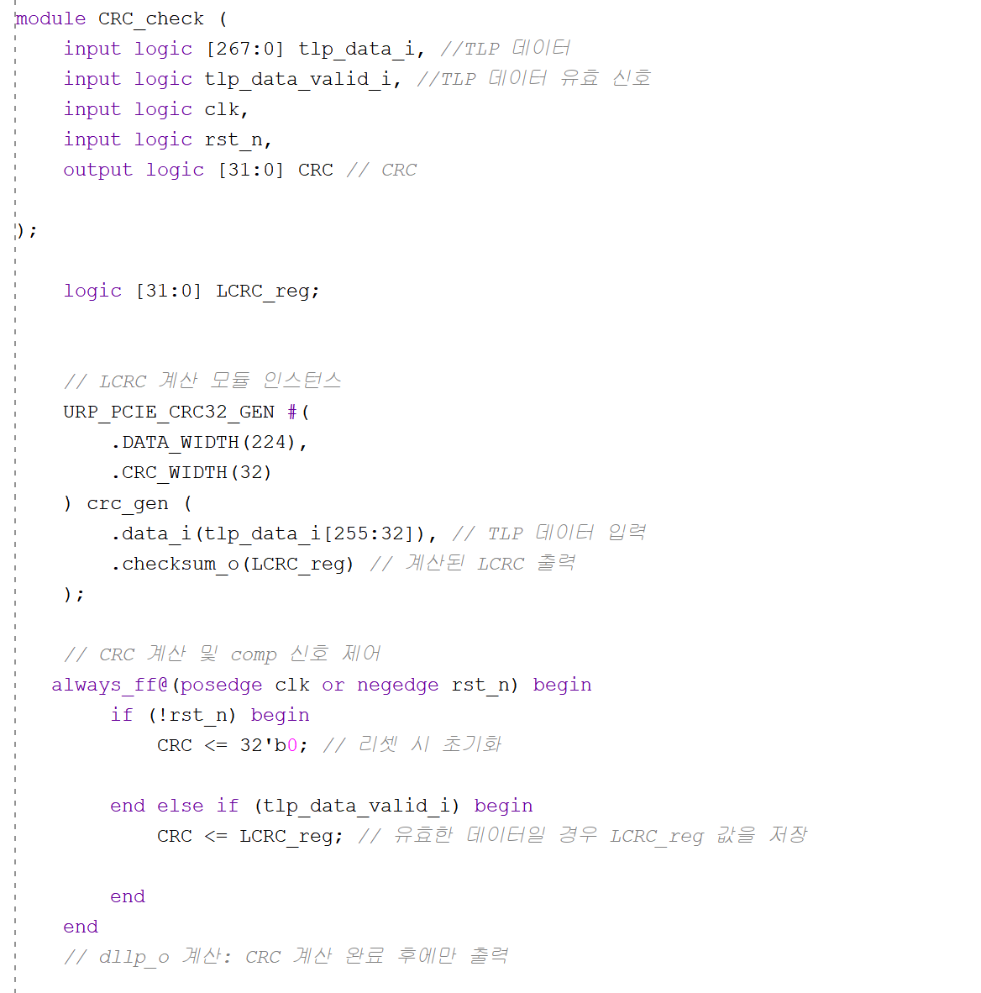
>>
CRC check module
Part 2-4
System Verilog Implementation

Slide 22
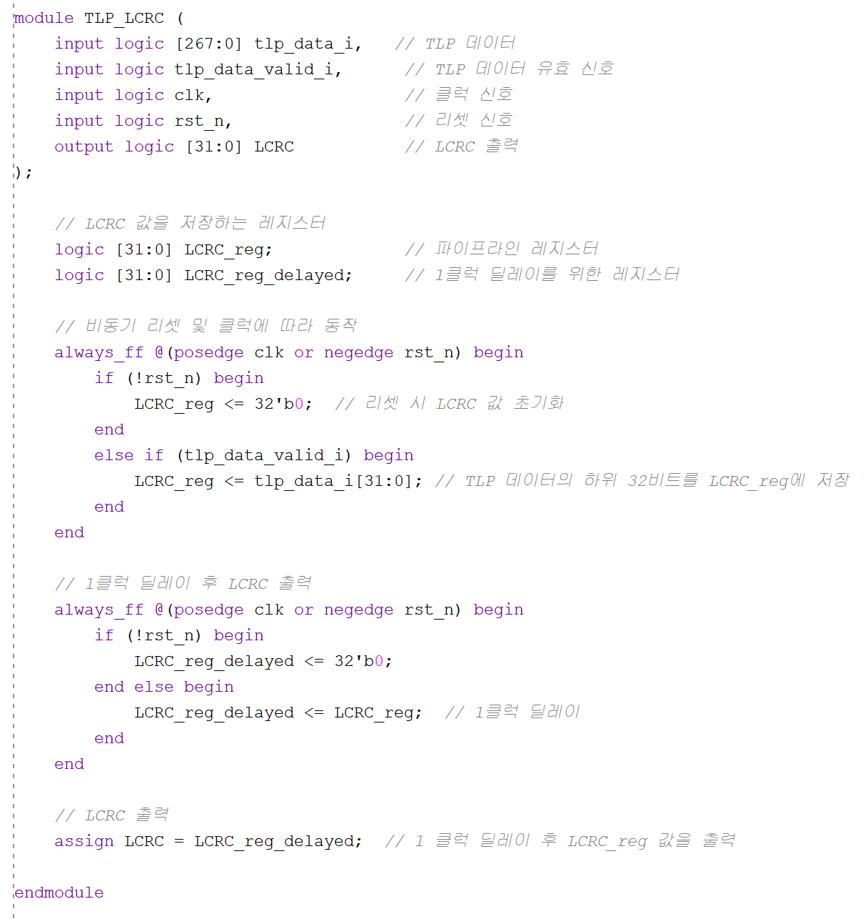
>>
TLP_LCRC module
Part 2-4
System Verilog Implementation

Slide 23
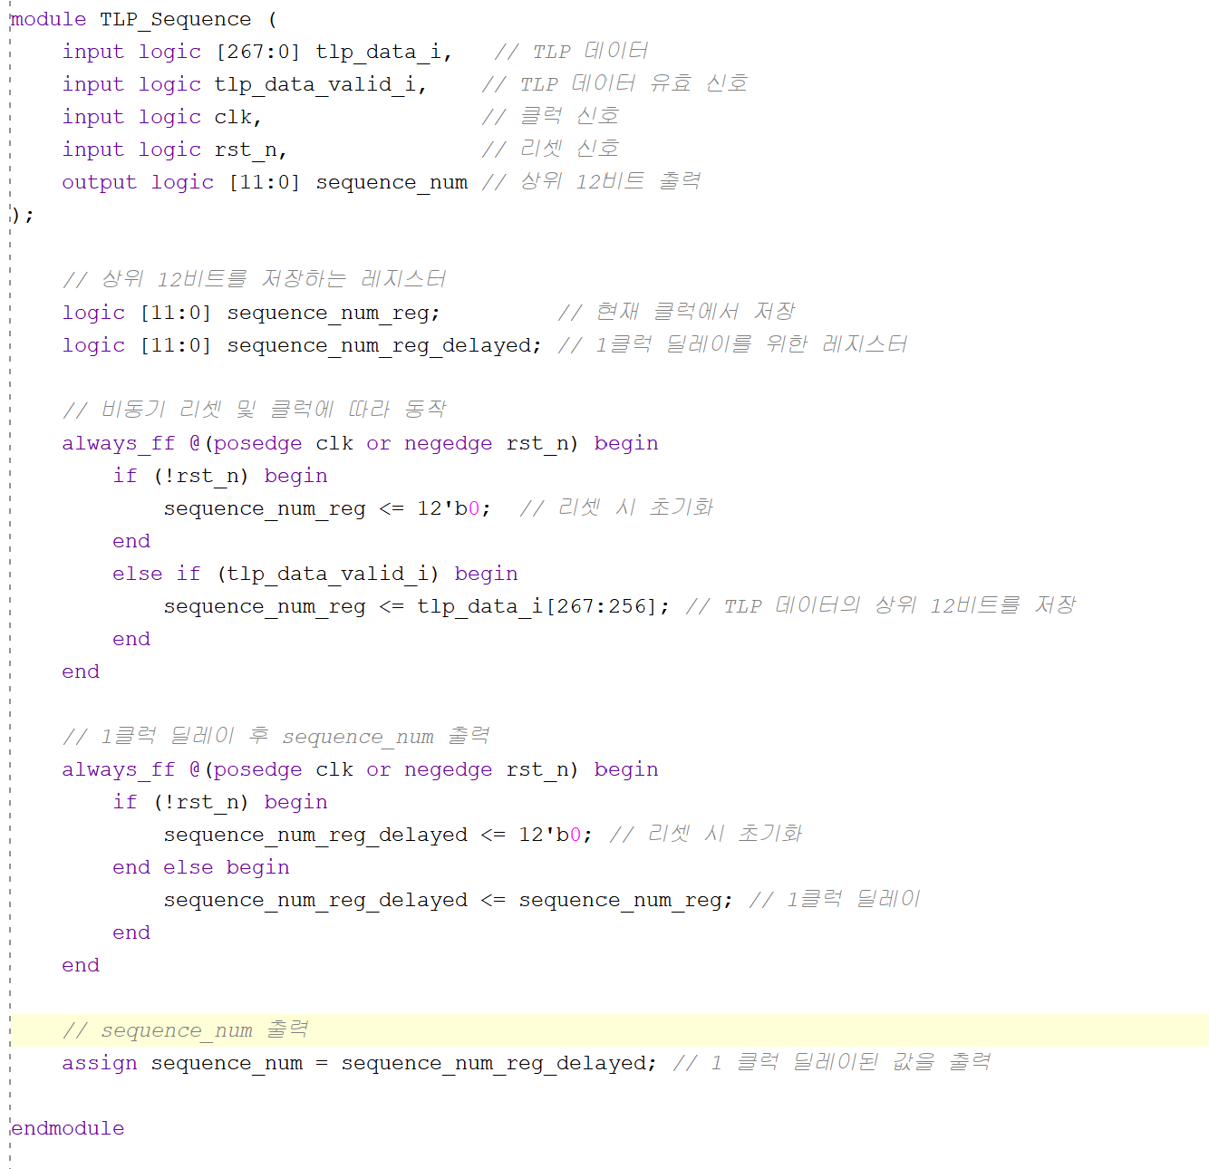
>>
TLP_Sequence module
Part 2-4
System Verilog Implementation

Slide 24
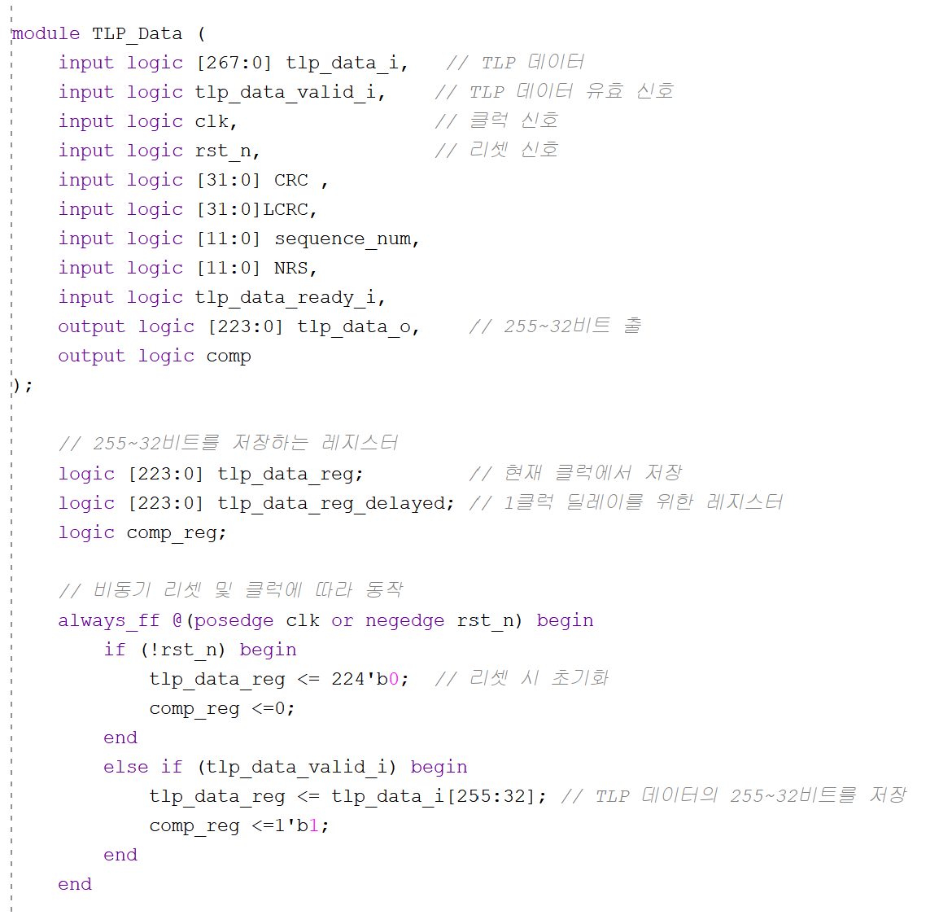
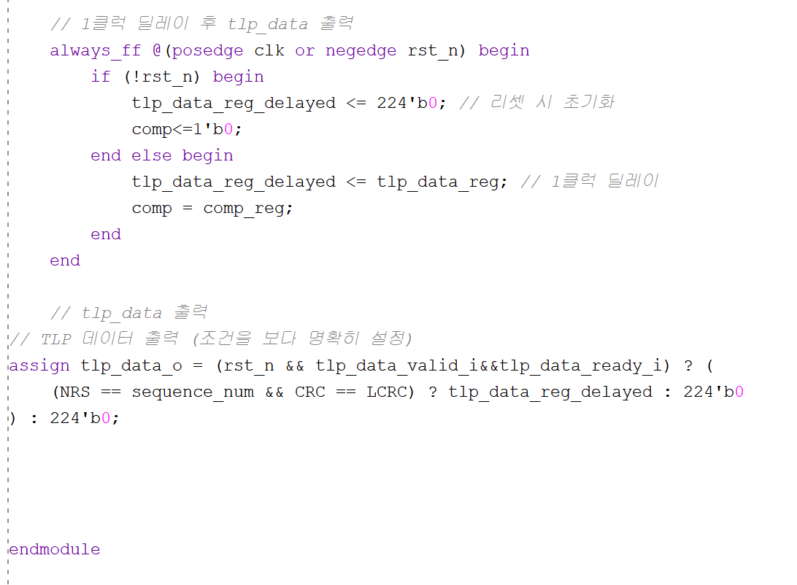
>>
TLP_Data module
Part 2-4
System Verilog Implementation

Slide 25
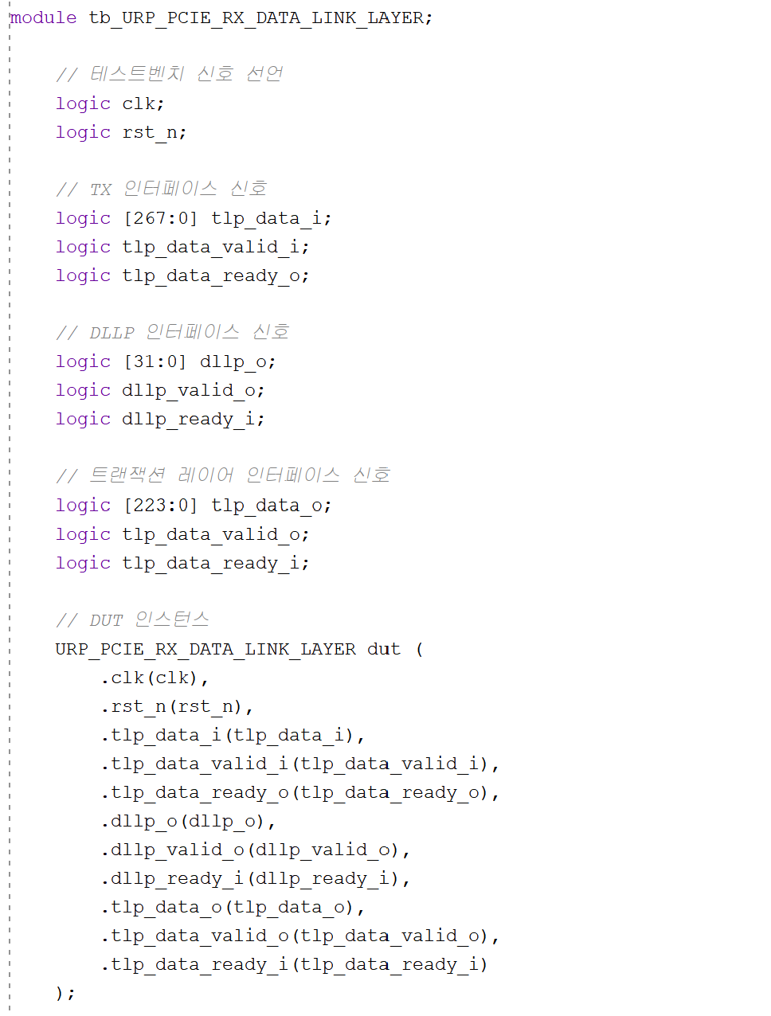
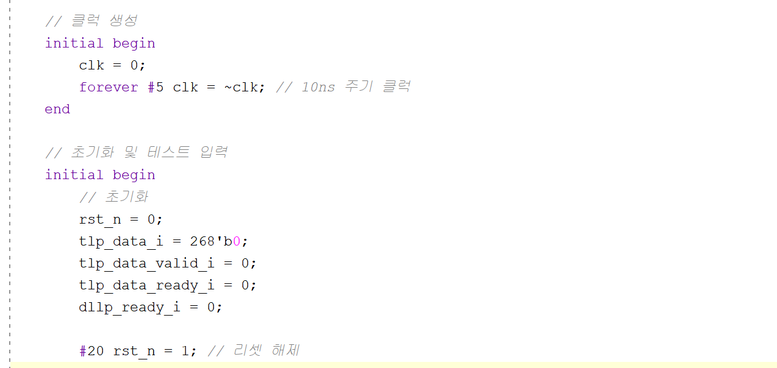
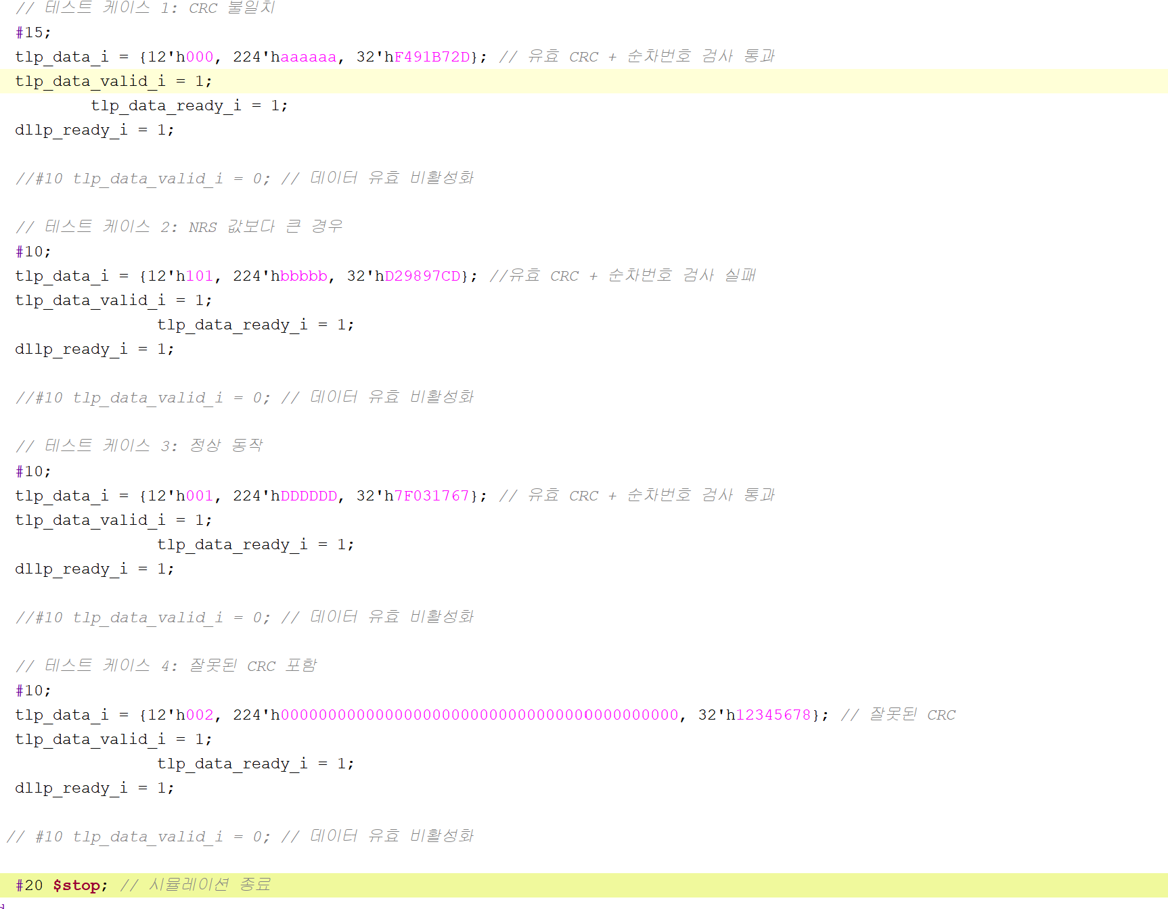
>>
Testbench module
Part 2-4
System Verilog Implementation

Slide 26

>>
Testbench module
Part 2-4
Simulation Result

Slide 27

>>
TX Module
Part 2-5
Simulation Result

Slide 28

>>
RX Module
Part 2-6
Simulation Result

Slide 29

>>
TOP Module
Part 2-7
Simulation Result (1)

Slide 30

>>
TOP Module
Part 2-7
Simulation Result (2)

Slide 31
Improvement

Slide 32

>>
Timing
Part 3
Simulation Result of detail wave form

Slide 33


>>
Improved FIFO module
Part 3
System Verilog Implementation
Simulation Result

